Slide 1

Fifa – 19 Analysis
Done by:
t.Sai rahul(pes1201801232)
Manohar (pes1201800382)
Rineeth (pes1201800179)

Slide 2
Introduction :
FIFA 19 is football simulation video game developed by EA Vancouver as part of Electronic Arts FIFA series and played in Xbox 360, Playstation 3 and 4, Microsoft windows.It is widely played by the gaming and football fans all over the world.

Slide 3
Scope :
The complete analysis of involving each and every player’s
stats useful for football gamer’s.Next time when you wish to play FIFA 19, we will give you the proper insights containing which is
the best team to choose and quickest players,strongest
defenders, best passer, bestfinisher etc.

Slide 4
Steps to Analyse the data :
Cleaning and Normalization
Cleaning Data Using Interpolate Replace ffill mean and meadian methods , Normalizing Integer columns
Graphs And Co-Relation
Visualizing using Piechart , BarGraph , ScatterPlot,Linegraph and corelating columns of cleaned and unclean data.
Hypothesis Testing
Testing the hypothesis in varies ways.

Slide 5
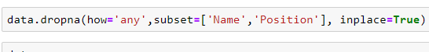
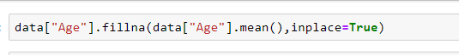
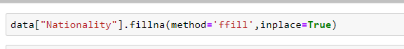
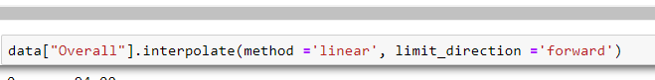
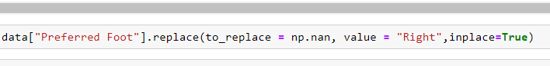
Cleaning the data :
Different ways of cleaning data :

Slide 6
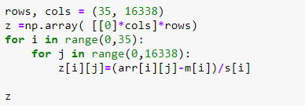
Normalizing the data :
Data has been standardized to z-scores of respective values and the mean is made zero and standard deviation as one.
Few of the columns are skewed to right or left and cannot be normalized.

Slide 7
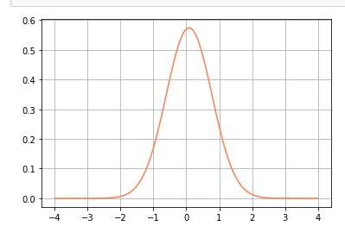
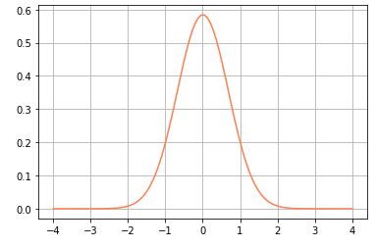
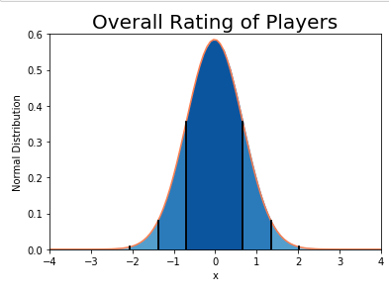
Normal distribution curves :
Weight
Height
Notes:
shk

Slide 8
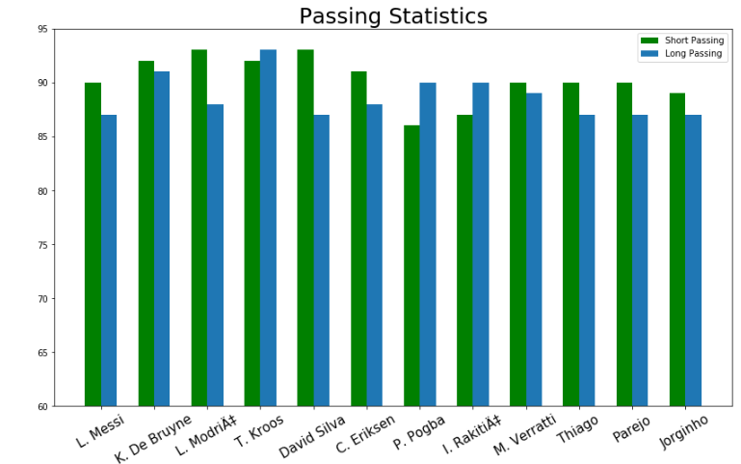
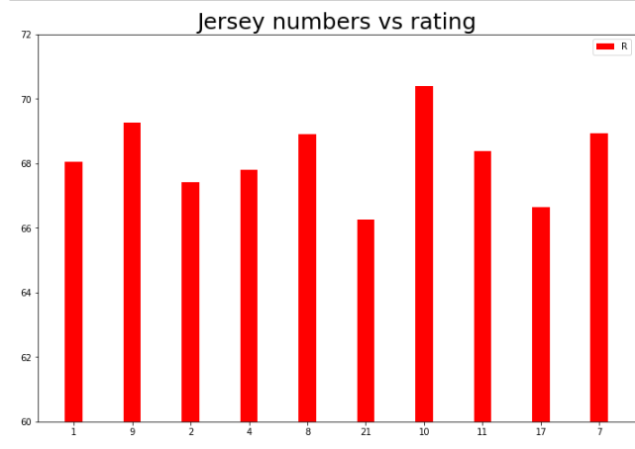
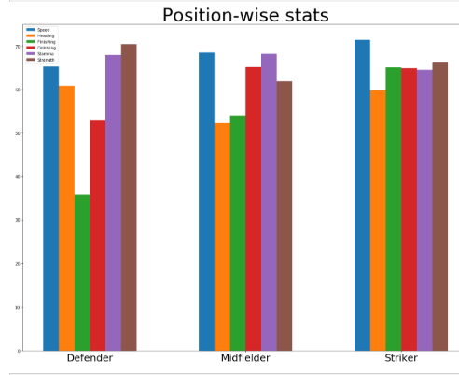
Visualization (bar)

Slide 9
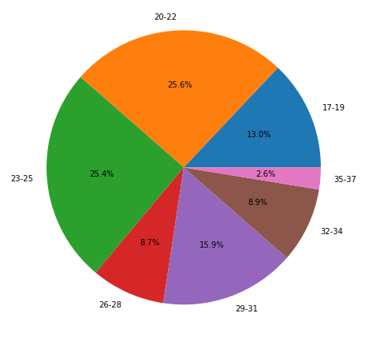
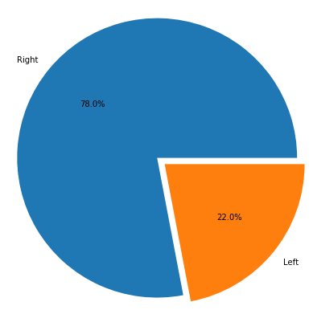
Visualization (pie)
Age vs F
Right vs Left
Notes:
soijg

Slide 10
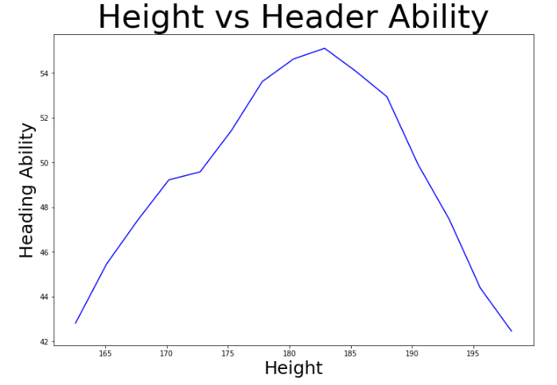
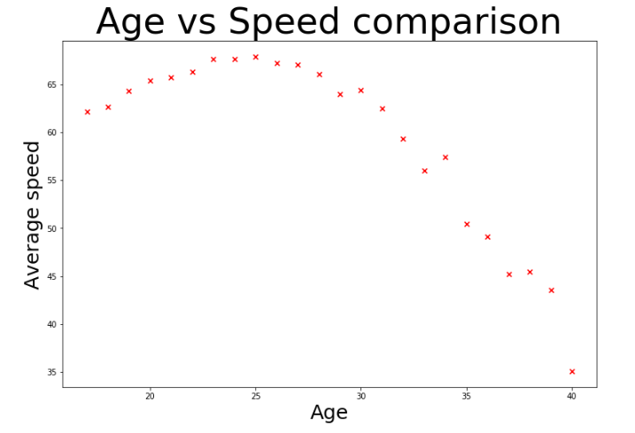
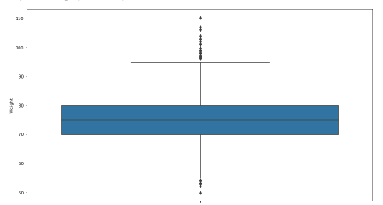
Visualization (Line , scatter , box)
Weight

Slide 11
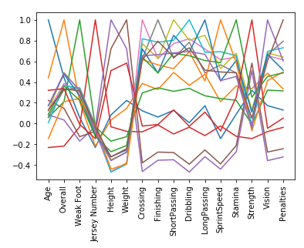
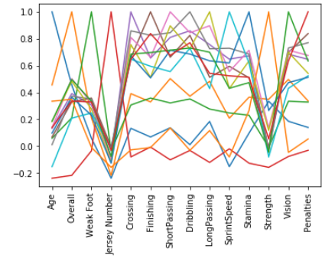
correlation
Unclean
Clean
Notes:
kjs

Slide 12
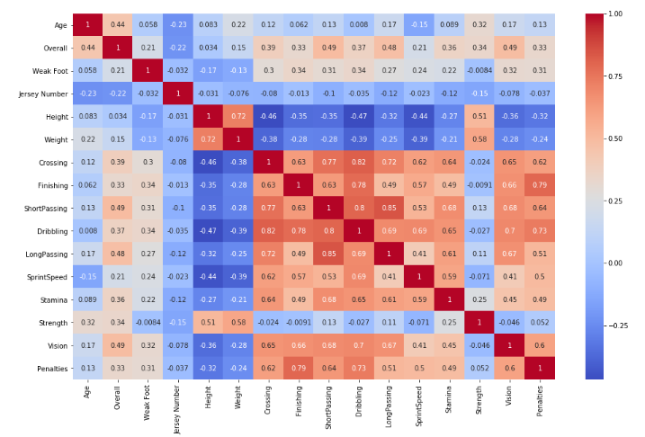
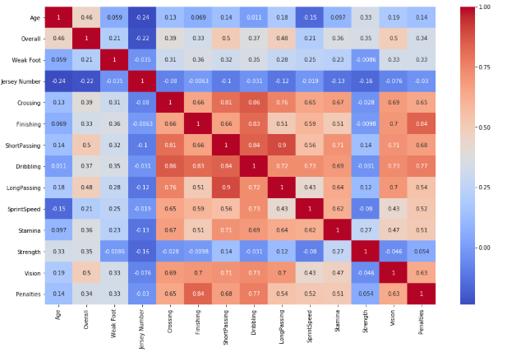
correlation
Unclean
Clean

Slide 13
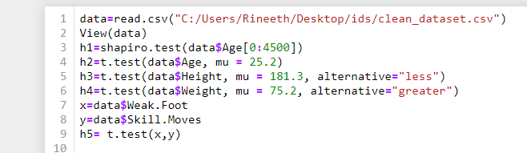
Hypothesis testinG

Slide 14
